Slide 1
Team 5
Project Final Progress Report
Ruoning Ren/Huangshuai Shi/Jiahui Xi
05/17/2022

Slide 2
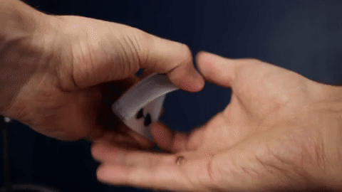
Objective Overview
Apply Engineering to simulate the Card Spring
Adapted HW codes for the card spring simulation project
Implemented the DEB (discrete elastic beam) and DER (discrete elastic rod) method
Completed simulation of Flex-and-Release motion

Slide 3
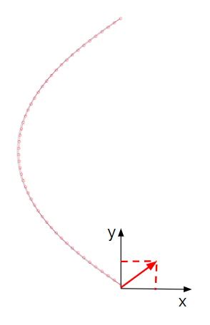
Simulation Approaches
DEB - Discrete Elastic Beam(2D）
Assumptions:
Uniform distribution of mass
Uniform distribution of bending force on the top and bottom edges of the card.
Decoupled force components are parallel to x-axis and y-axis, no z-axis component

Slide 4
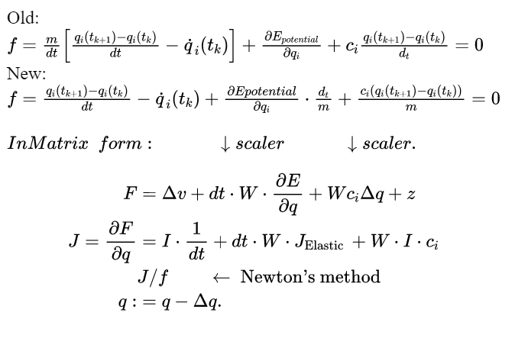
Methods
Newton Raphson
Implemented the Newton Raphson iterative method learned from class
Mass Modification
Incorporated Mass Modification in constraint and contact force definition

Slide 5
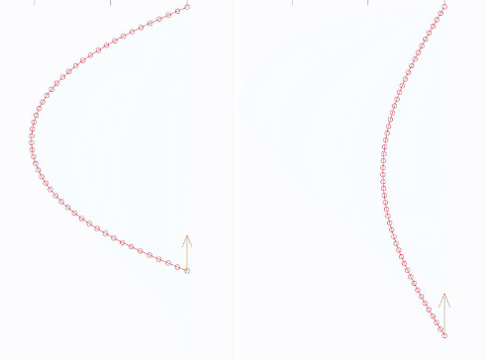
Phases of simulation
Phase I:
Bending the card until it reaches a designated equilibrium form
Top node fixed in the x and y directions
Bottom node fixed in the x direction
Implemented PD controller to imitate the hand’s action of bending the card
With PD
control
Without PD control

Slide 6
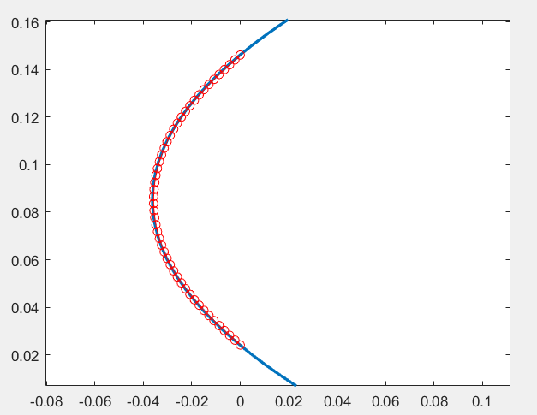
Phases of simulation
Phase II: with constraint
Card oscillates and rebounds against the card behind
Boundary is set -0.003m in x-direction in the same form as bent card
Shape of bent card is approximated by fitting a 2nd degree polynomial

Slide 7
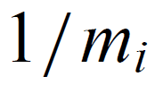
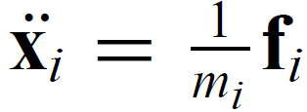
Mass Modification
Take the inverse of the original mass matrix such that the elements on the diagonal will become 1/m_{i}
The acceleration of node i will become

Slide 8
Mass Modification
When imposing a constraint in the i-th node, the mass matrix is modified in the i-th term on the diagonal. Each term on the diagonal has size of 2x2 corresponding to the x-component and the y-component (DEB approach)
To add constraint in a certain axis, make the corresponding component to zero.
Thus, only the accelerations on unconstrained nodes/their unconstrained axes are considered.

Slide 9
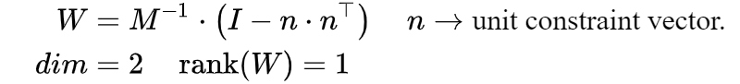
Mass Modification
When the constraint has components on both x and y axes, for example, when a node is restricted of accelerating along n (a unit vector with x and y components), the inverse mass matrix becomes 1/m_{i}(I - n_{i}n_{i}^{T})
When obtaining the Δv_{i} consistent with the constraint, a velocity component z_{i} along the constraint n will be imposed to balance the equation of motion constituted by Newton’s 2nd law.

Slide 10
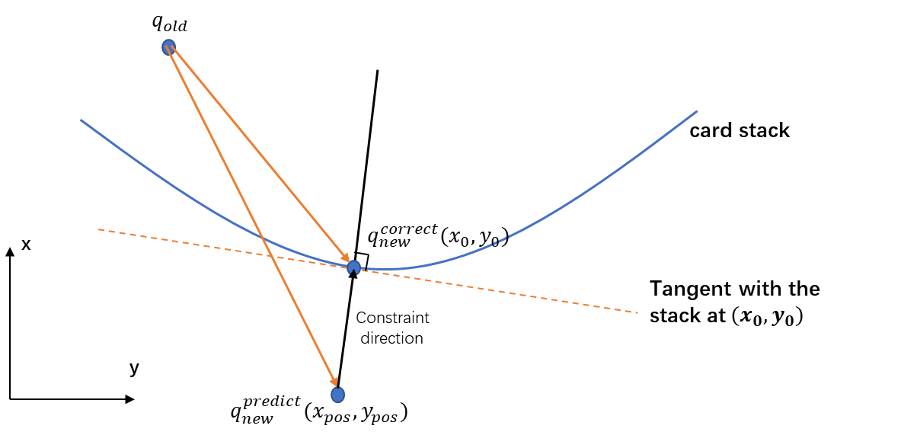
Constraint Definition
The physics behind:
The force for mass modification is defined as follows:
Where ‘z’ is calculated in code as:
n is defined by :
normvec = ([x0;y0] - [xpos;ypos])/ norm([x0;y0] - [xpos;ypos])
And z is defined by :
z(2*i-1:2*i) = ([x0;y0] - [xpos;ypos]) / dt;
(normvec is the direction of constraint)
Notes:
Important procedure of mass mod is to calculate n
Complex since the constraint - quadratic
First do prediction without constraint
Then find true position under constraint
There are 2 conditions to find the satisfactory contact point.
1st the contact point lies on the constraint boundary
2nd the tangent line through this contact point must be perpendicular to the line that passes through both points

Slide 11
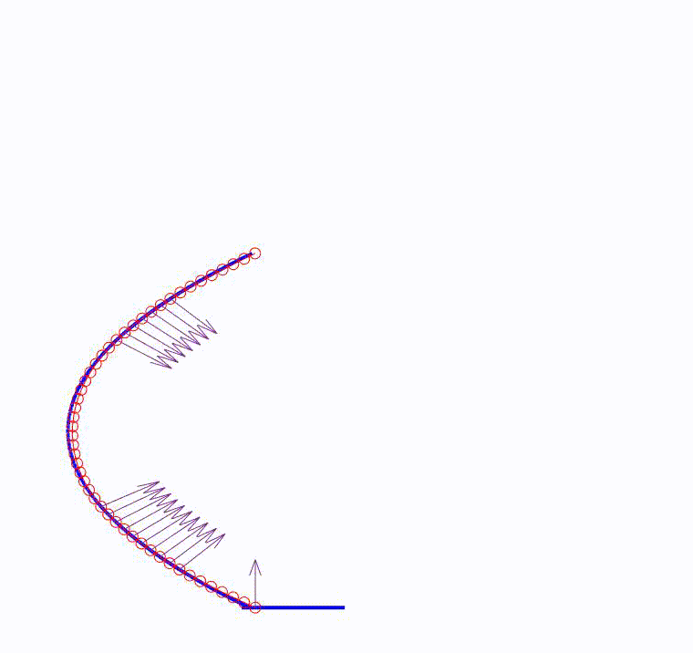
Phase II Motion Demo

Slide 12

Phases of simulation
Phase III:
Free oscillation and motion
after leaving from boundary contact
Contact with ground until end of motion

Slide 13
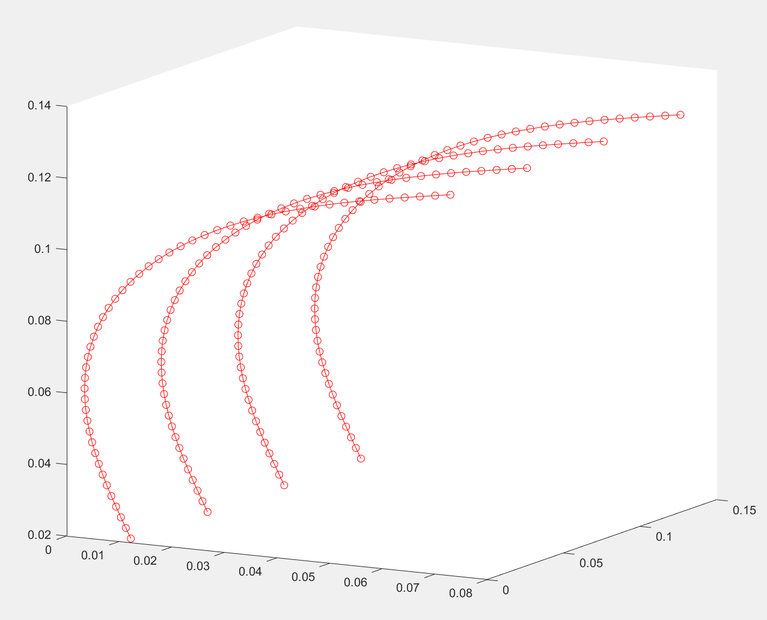
Card Representation
In All Phases:
The positions of the nodes (x,y) is transformed into (x,z) coordinates
Each beam is duplicated 3 times
Evenly spaced out into the +y direction
To construct a representation of the card, edge lines of the card are displayed in red

Slide 14
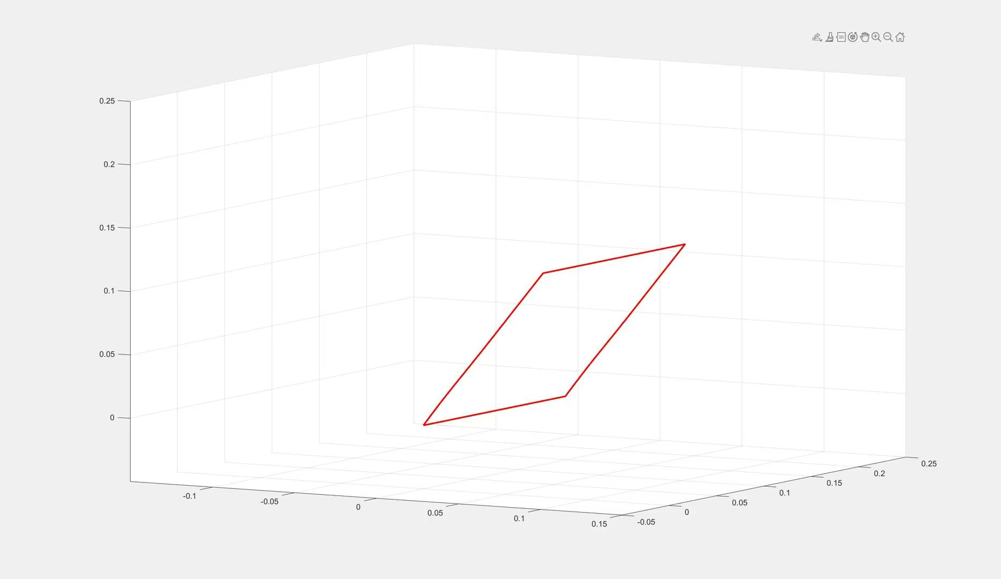
Single Card following

Slide 15
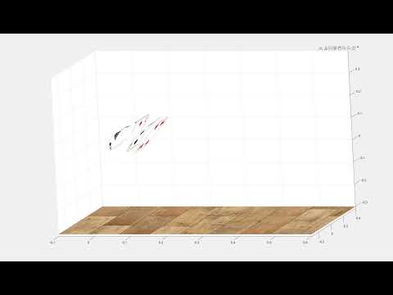
Multi–Card spring with Render

Slide 16
In the Future
Collision and contact between cards should be simulated
Better visual rendering with Three.js
More sophisticated modelling techniques (Discrete Elastic Plates)

Slide 17
Thank you

Slide 18
Appendix – Key Equations

Slide 19
Appendix – References
[1] Baraff, David, and Andrew Witkin. "Large steps in cloth simulation." In Proceedings of the 25th annual conference on Computer graphics and interactive techniques, pp. 43-54. 1998.
[2] Bergou, M., Wardetzky, M., Robinson, S., Audoly, B., and Grinspun, E. Discrete elastic rods. In ACM SIG GRAPH 2008 Papers (2008), SIGGRAPH ’08, pp. 63:1–63:12.

